Slide 1
Project 3- Data Science Skills
CITYTECH UNIVERSITY
Team: Daria Dubovskaia, Wilson Chau, Seung Min Song, Ted Kim
Notes:
Amr

Slide 2
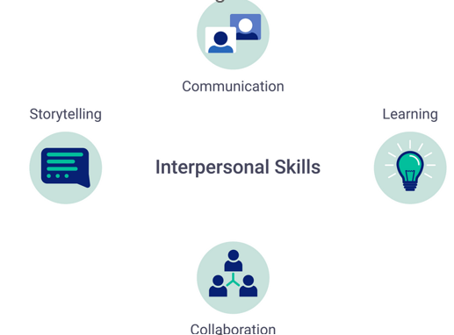
Objective
Answer the question, “Which are the most valued data science skills?”
Expand knowledge of data collecting, tidying, transformations, and exploratory data analysis in R.
Notes:
Jose

Slide 3

Approach
Analyze the chosen data set to understand the skills which will be considered the most valued for a Data Scientist. We are going to determine it using experimental method based on our teamwork.
Notes:
Jose

Slide 4
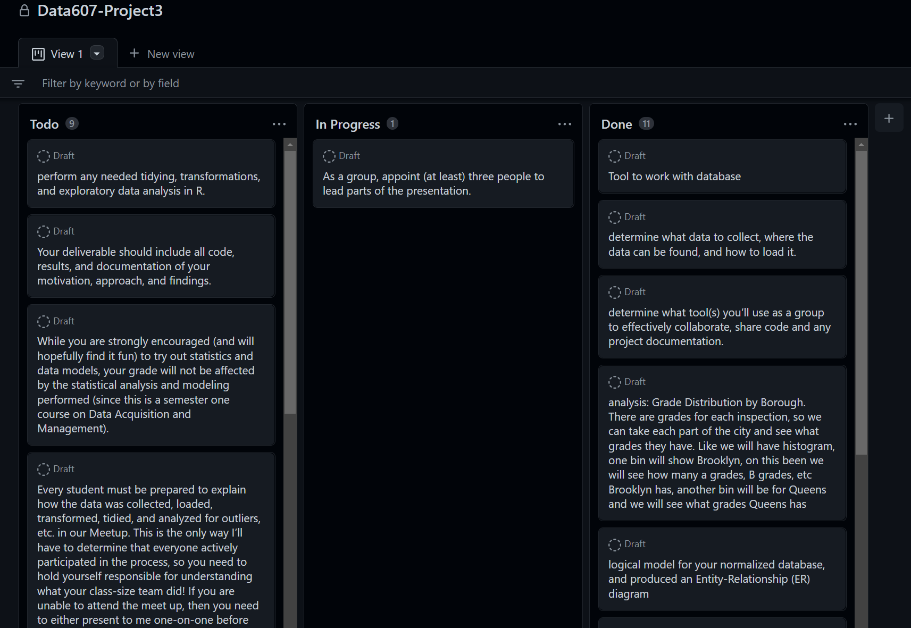
Collaboration Tools
Slack: The main communication tool
Github: Code sharing
Github Board: Project Management
Azure: Database sharing
Rpubs: Final R markdown sharing
Rstudio: coding
Github Board
Notes:
Jose

Slide 5
Methodology
Load dataset from the source into R
Tidy/Transform in R to a set of normalized tables
Load relational database into Microsoft Azure
Conduct analyses in R

Slide 6
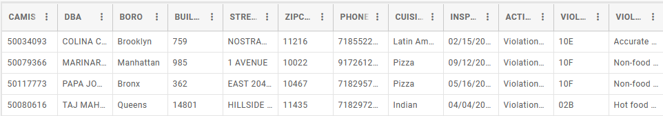
Data Source
DOHMH New York City Restaurant Inspection Results.
Download as a CSV file, load in R with read.csv().
27 columns, 239k observations.
Observation: restaurant inspection results or who has applied for a permit but has not yet been inspected
Transform into 13 tables. Identified by the CAMIS number.
Notes:
Jose

Slide 7
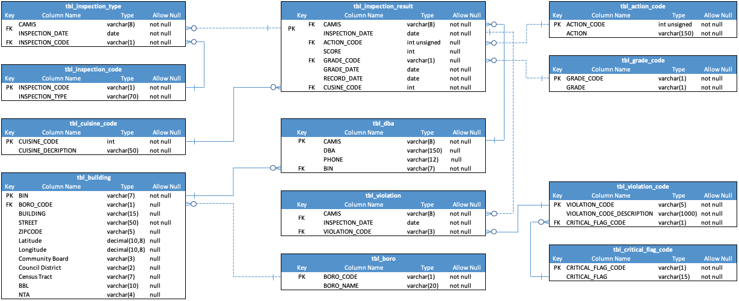
Entity-Relationship diagram
Notes:
Jose

Slide 8

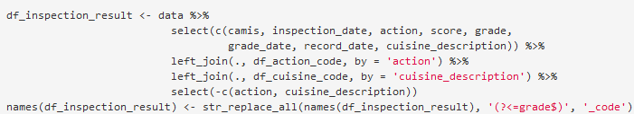
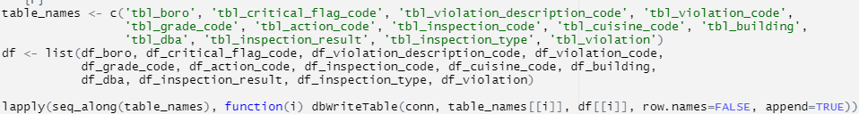
Create tables, database
Manually (3 tables)
Based on the ID, code name (10 tables)
Load to database
Notes:
Jose

Slide 9
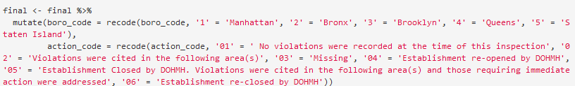

Prepare data
Load 13 tables from the database with dbReadTable()
Combine tables
Replace codes
Work with missing values
Notes:
Jose

Slide 10
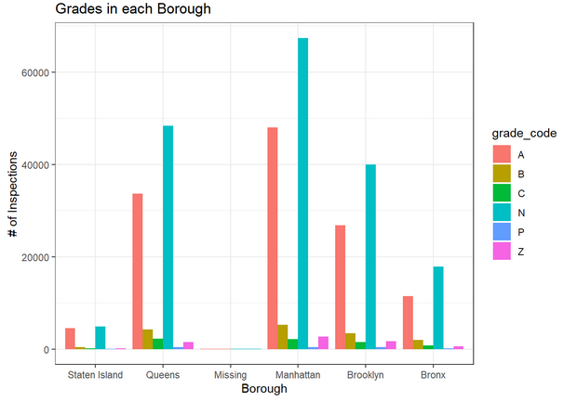
Explanatory analysis
Notes:
Jose

Slide 11
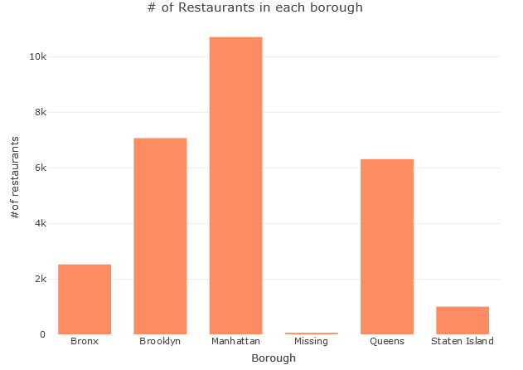
Explanatory analysis
Notes:
Jose

Slide 12
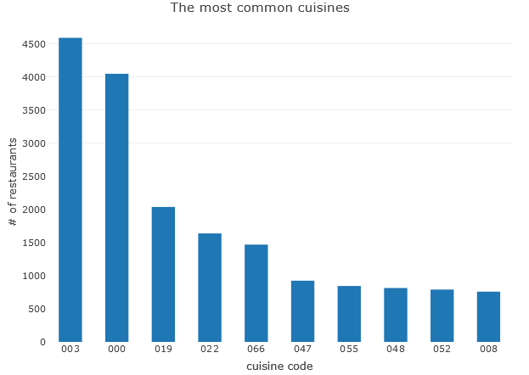
Explanatory analysis
Notes:
Jose

Slide 13
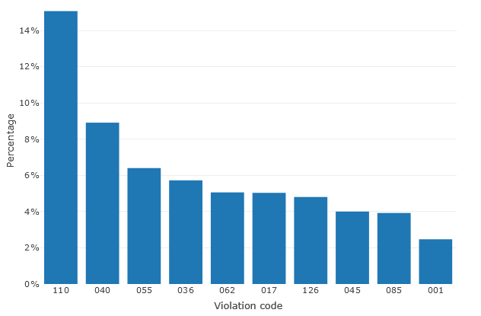
Explanatory analysis
Notes:
Jose

Slide 14

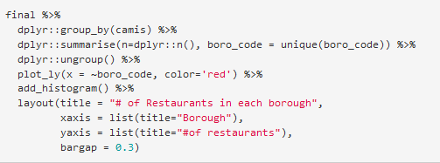
Explanatory analysis
Notes:
Jose

Slide 15






Conclusion
1
2
3
4
5
Collaboration
Understand the value of teamwork and communication
Learn data
Understand data, be careful with a research question
Check your work
To find mistakes
Documentation
To get all the answers
Database
Expand knowledge
Notes:
Daria

Slide 16
Resources
Slack https://slack.com/
GitHub https://github.com/blacksmilez/DATA607/tree/main/Project3
Microsoft Azure Database https://azure.microsoft.com
Rpubs https://rpubs.com/exprmcg/960712

